Slide 1


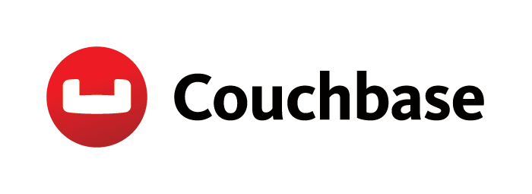
Secure Offline Mobile Apps
Mobile Tea Meetup #13

Slide 2


| William Hoang | Mobile Developer Advocate |
@sweetiewill

Slide 3
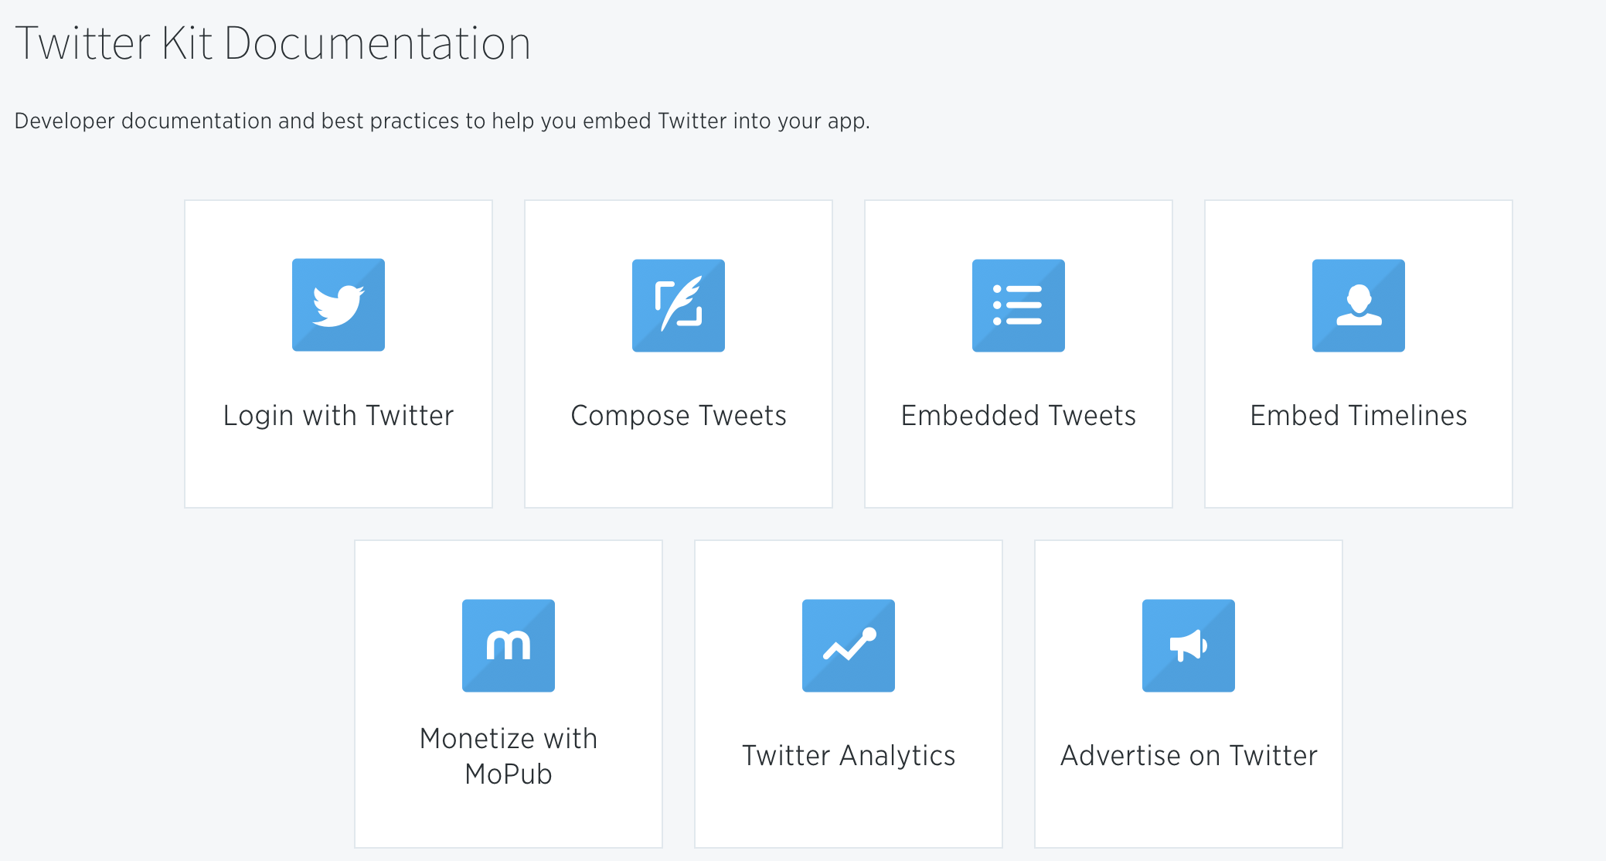
@twitterdev

Slide 4
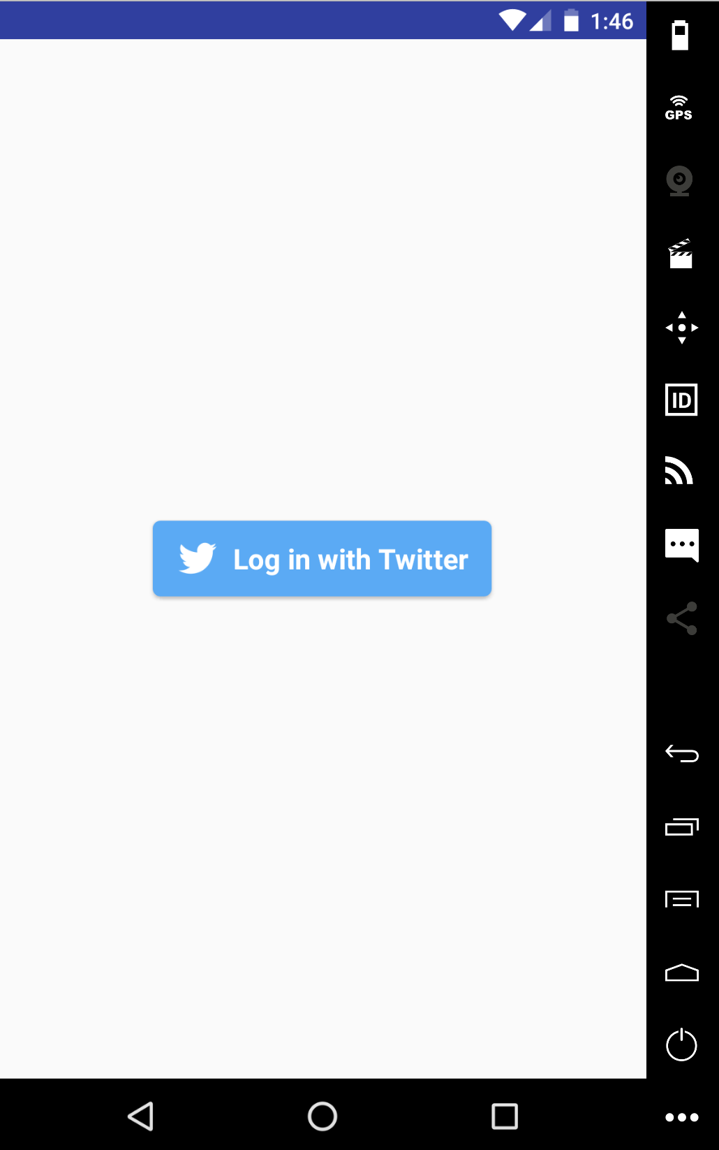
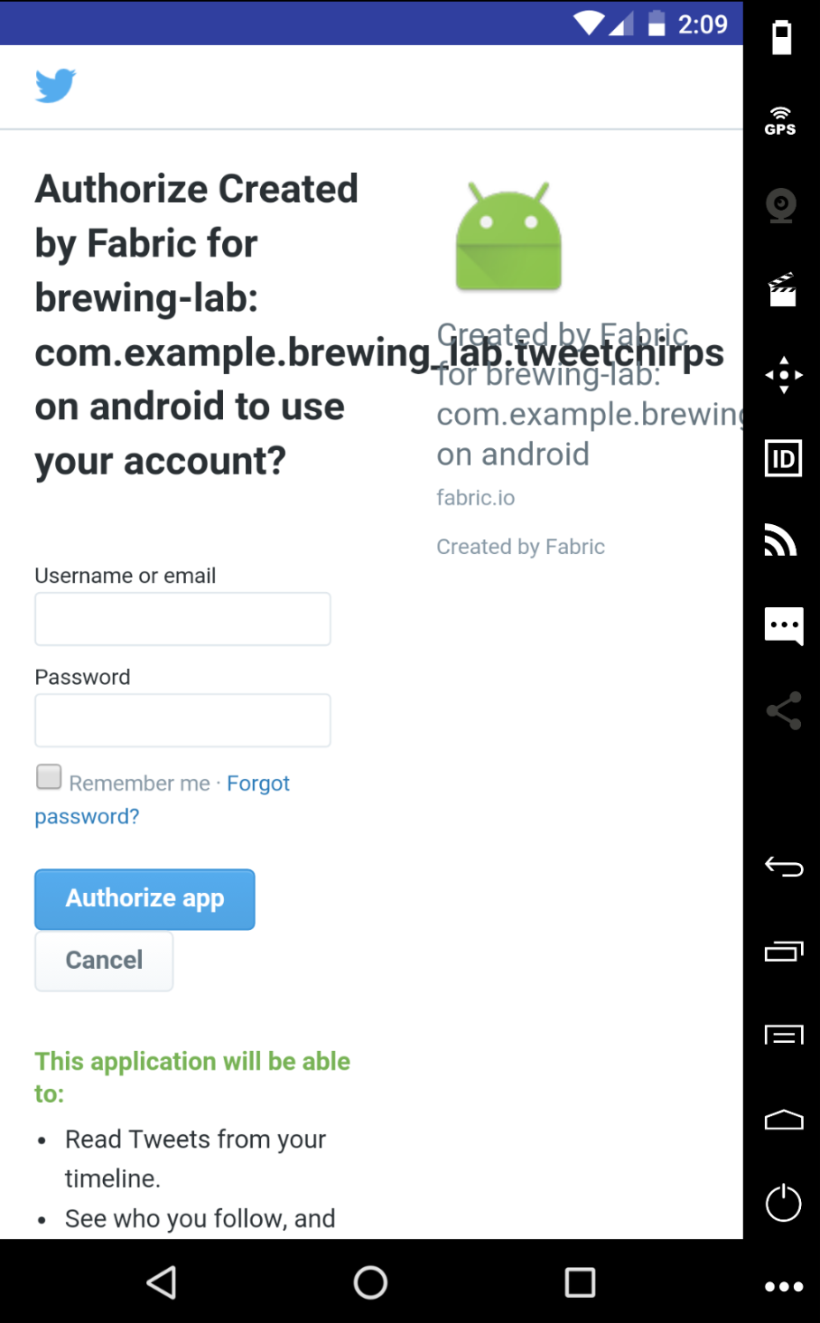

sweetTweet App Summary

Slide 5
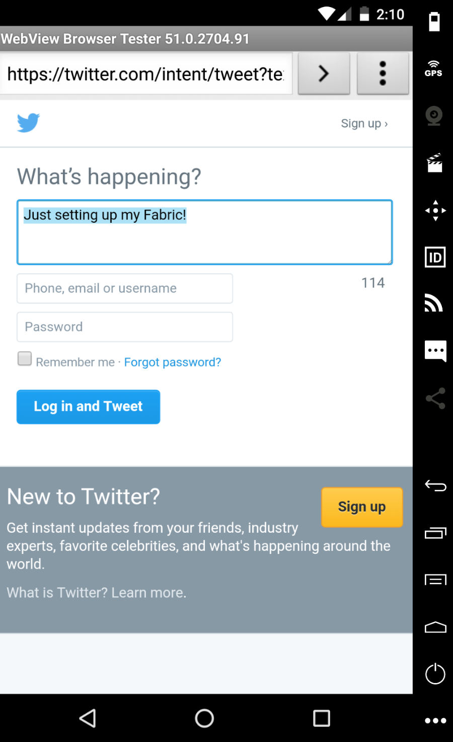
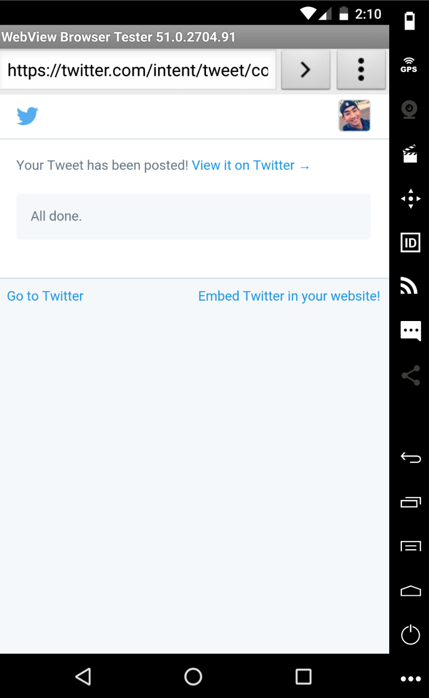
sweetTweet App Summary

Slide 6

Twitter Timeline

Slide 7
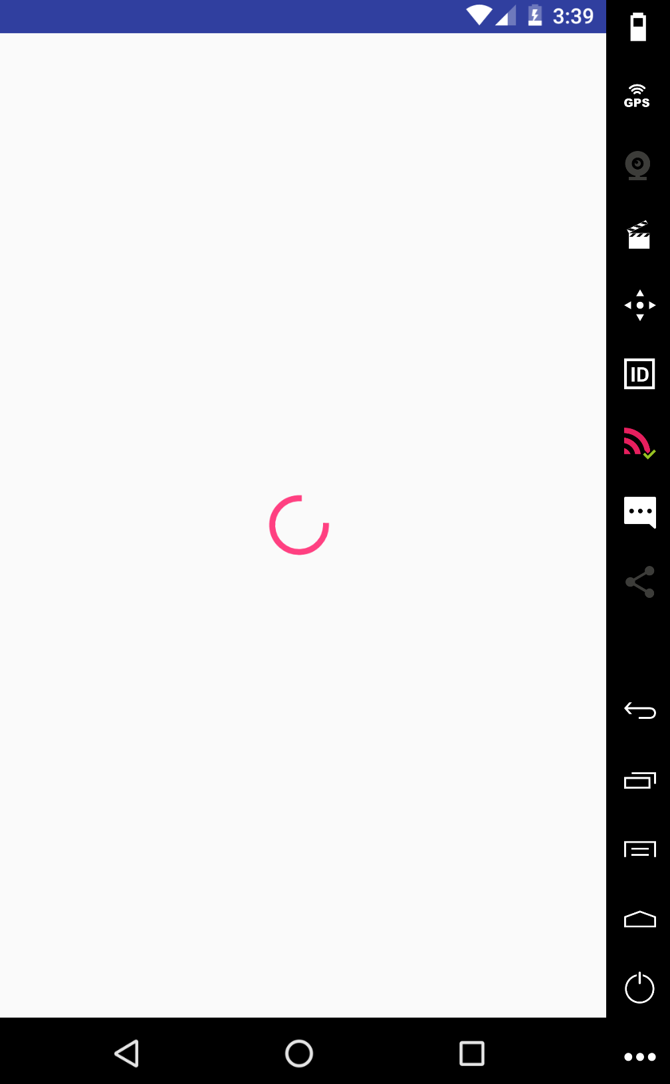
No Internet..

Slide 8
No Twitter!!

Slide 9

Couchbase Lite
Sync Gateway
Couchbase Server
Notes:
Couchbase Lite is an embedded database that runs in-process on your device which you bring in to your game project. Sync Gateway is the sync cloud component or bridge that will handle the synchronization and replication/authentication issues between Couchbase Lite and Couchbase Server. Couchbase Server is the flagship product that is high performance and the highly scalable Cloud storage database.
Let’s touch and go over on each of these pieces a bit more. But before that, where is this available?
[CLICK]

Slide 10
Couchbase Lite
Sync Gateway
Notes:
Slide 14 - Couchbase Lite and Sync Gateway
Couchbase Mobile is a two part solution.
The first part is “Couchbase Lite” which is embedded into your mobile application.
The second part is “Sync Gateway” which sits between the boundary of your private cloud and the public cloud.
[Click] Couchbase Lite.
It is a NoSQL mobile database
It runs in-process and has a very small footprint. [Click]

Slide 11


Couchbase Lite
NoSQL mobile database.
Runs in-process.
Small footprint.
Notes:
Slide 15 - 4 Key Areas
The key features for Couchbase Lite are that [Click]
1- It provides you with a document orientated database [Click]
2 - It provides you with a map-reduce query engine [Click]
3 - It provides you with event notifications [Click]
4 - And it provides you with Sync abilities or in engineering terms, master-master replication.
[Click]

Slide 12

Secure Sync to Mobile Apps
Encryption: On Device Database
Data Encryption in Couchbase Server
Security Solutions with Sync Gateway
Notes:
Encryption: On Device Database
Securing database on device with either ForestDB or SQLCipher and would provide for 256-bit AES encryption of database files.
Data Encryption in Couchbase Server
With SSL enabled, data to and from the server is encrypted using the server certificate that is configured and stored in the client certificate store. There is also support for secure admin access and this would allow for administrators to securely browse and administer Couchbase Server through the browser even over a public network.
Security Solutions with Sync Gateway

Slide 13
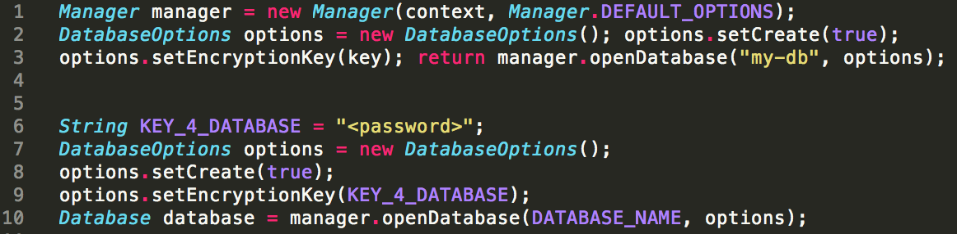
Secure Sync to Mobile Apps
Encryption: On Device Database
Enable SQLCipher
Security Solutions with Sync Gateway
Notes:
Encryption: On Device Database
[1] Register a password and key first before creating or opening an encrypted database
--behind the scenes here, a password string will be converted into binary data using PBKDF2 algorithm
[2] The same key needs to be registered before database can be re-opened
By opening the database with the database key, CBL automatically enables SQLCipher as a database storage.
[3] Then lastly the database key (password) need to be specified with ‘DatabaseOptions’

Slide 14
Secure Sync to Mobile Apps
Encryption: On Device Database
Data Encryption in Couchbase Server
Security Solutions with Sync Gateway
Secured Architecture
Notes:
Encryption: On Device Database
Securing database on device with either ForestDB or SQLCipher and would provide for 256-bit AES encryption of database files.
Data Encryption in Couchbase Server
With SSL enabled, data to and from the server is encrypted using the server certificate that is configured and stored in the client certificate store. There is also support for secure admin access and this would allow for administrators to securely browse and administer Couchbase Server through the browser even over a public network.

Slide 15
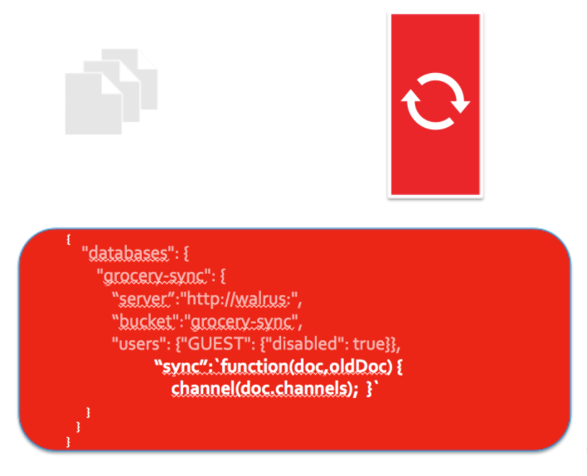
Secure Sync to Mobile Apps
Security Solutions with Sync Gateway
Notes:
Security Solutions with Sync Gateway
The Sync Function is a javascript function that is executed when any document is written into Sync Gateway. This is where the majority of Sync Gateway access rules are defined in the configuration file.

Slide 16
Couchbase Lite
Sync Gateway
Couchbase Server
Notes:
Couchbase Lite is an embedded database that runs in-process on your device which you bring in to your game project. Sync Gateway is the sync cloud component or bridge that will handle the synchronization and replication/authentication issues between Couchbase Lite and Couchbase Server. Couchbase Server is the flagship product that is high performance and the highly scalable Cloud storage database.
Let’s touch and go over on each of these pieces a bit more. But before that, where is this available?
[CLICK]

Slide 17
Replication
Authentication
Data Partitioning
Data Access Control
Couchbase Lite
Sync Gateway
Notes:
Sync Gateway Introduction

Slide 18
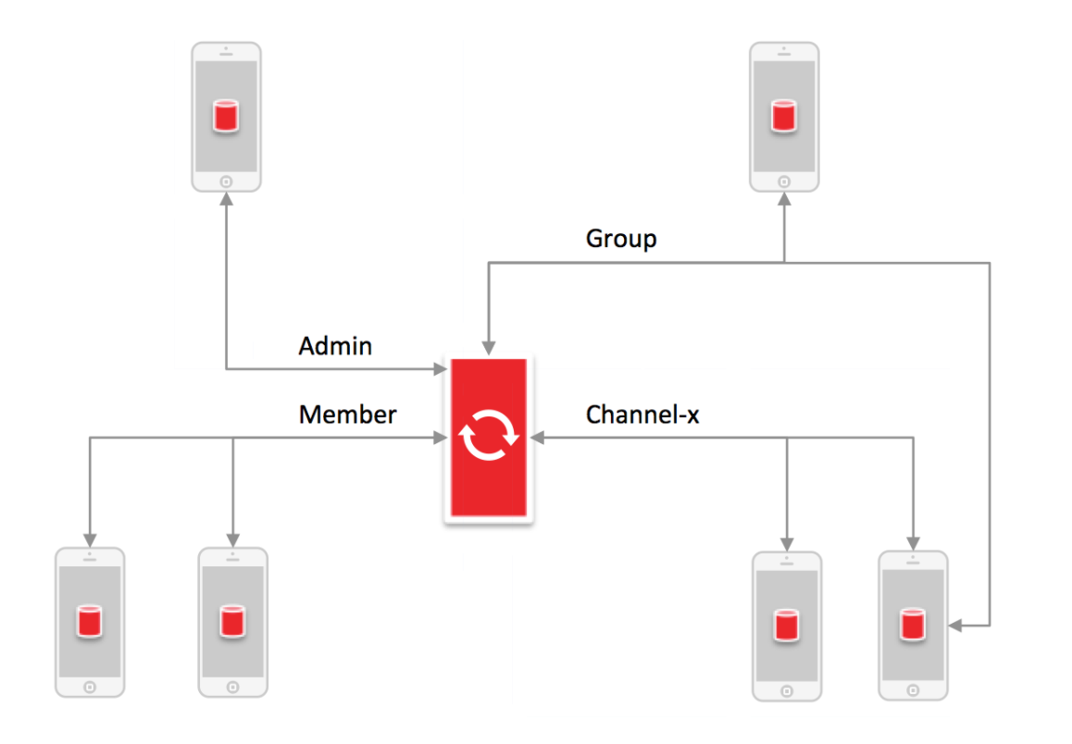

Slide 19
Couchbase Lite

Slide 20
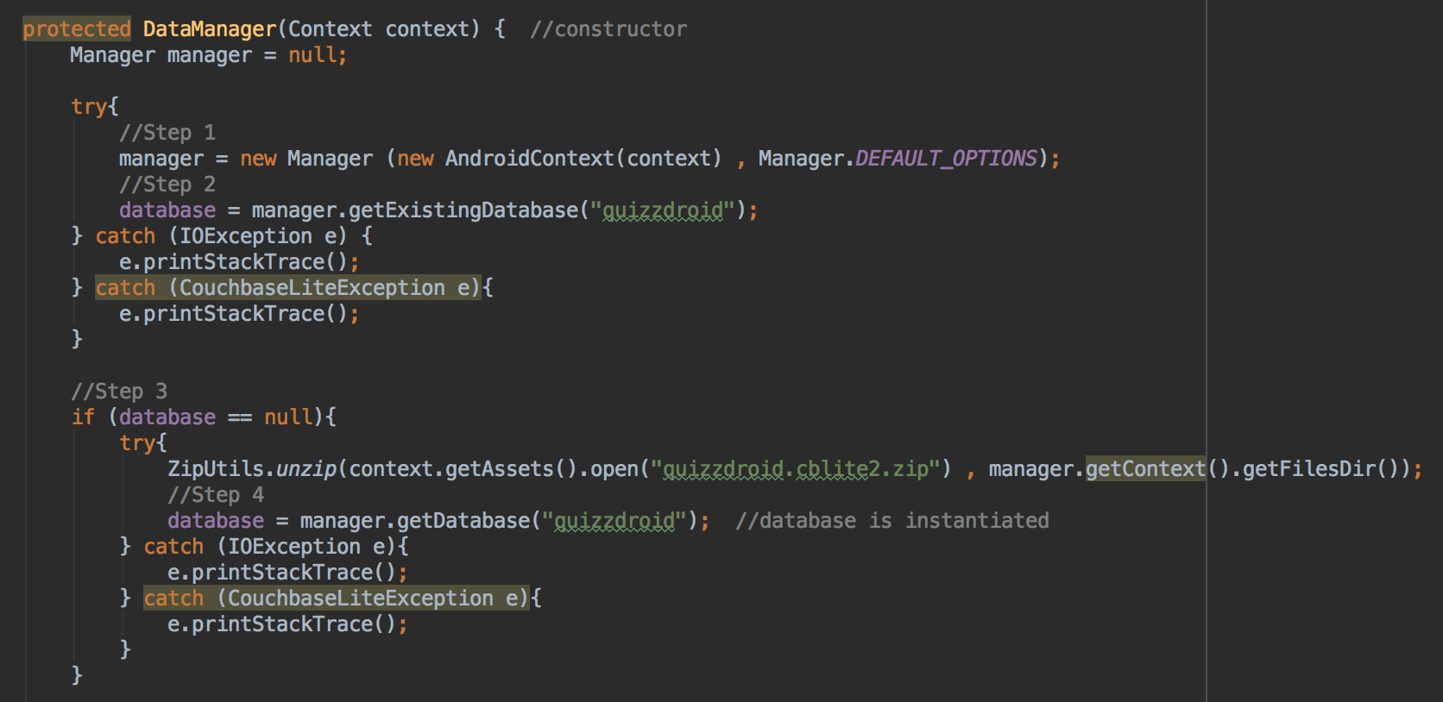
Initializing the Database

Slide 21
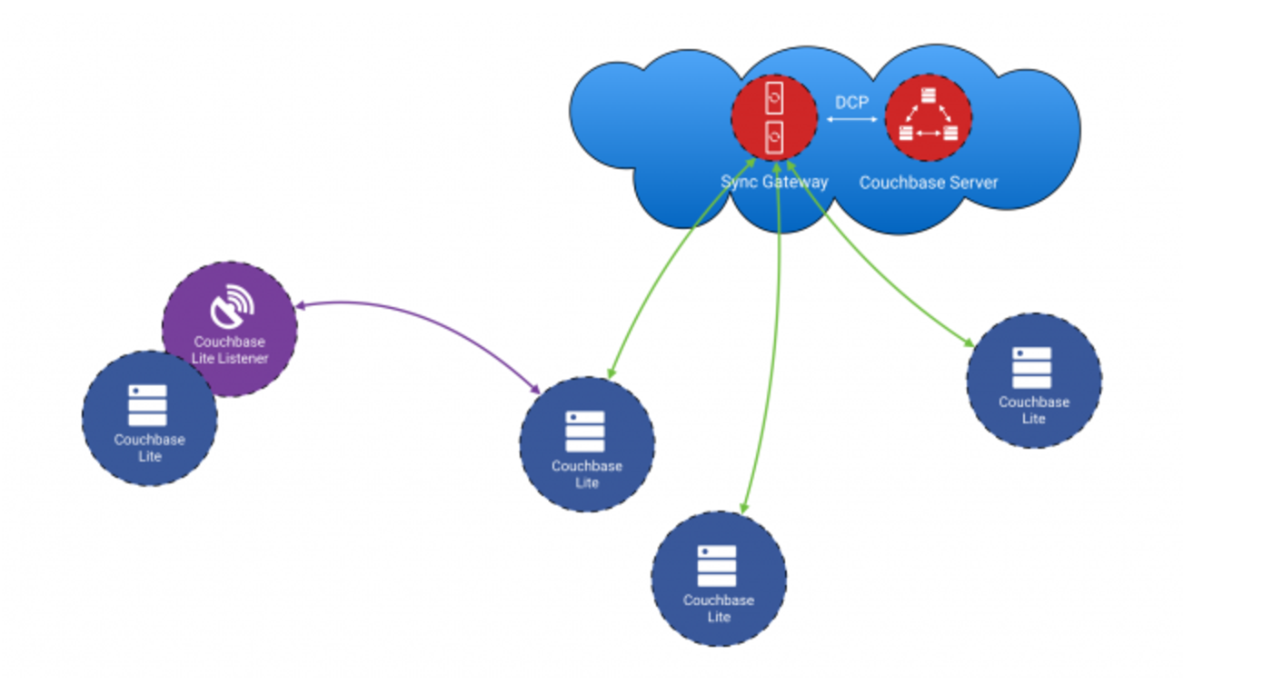
Infrastructure

Slide 22
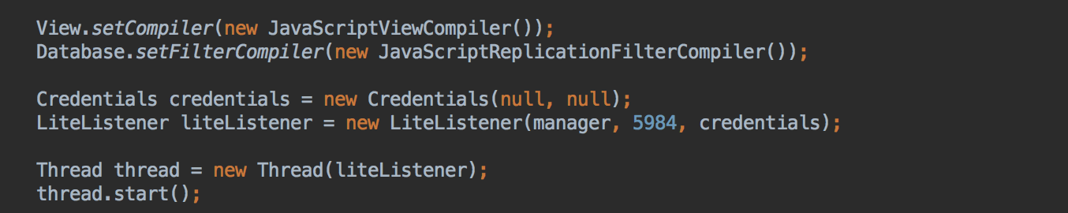
Database Listener

Slide 23
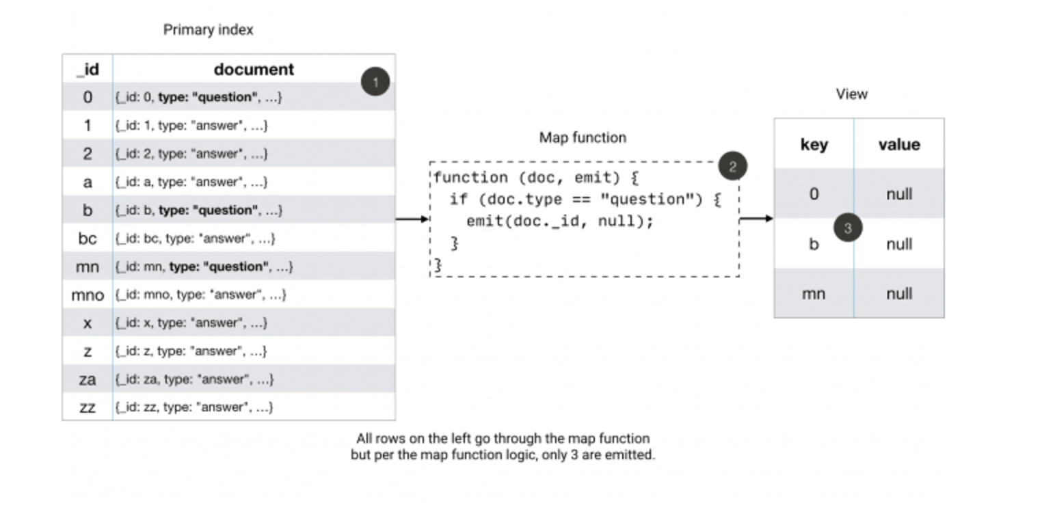
Data Indexing

Slide 24
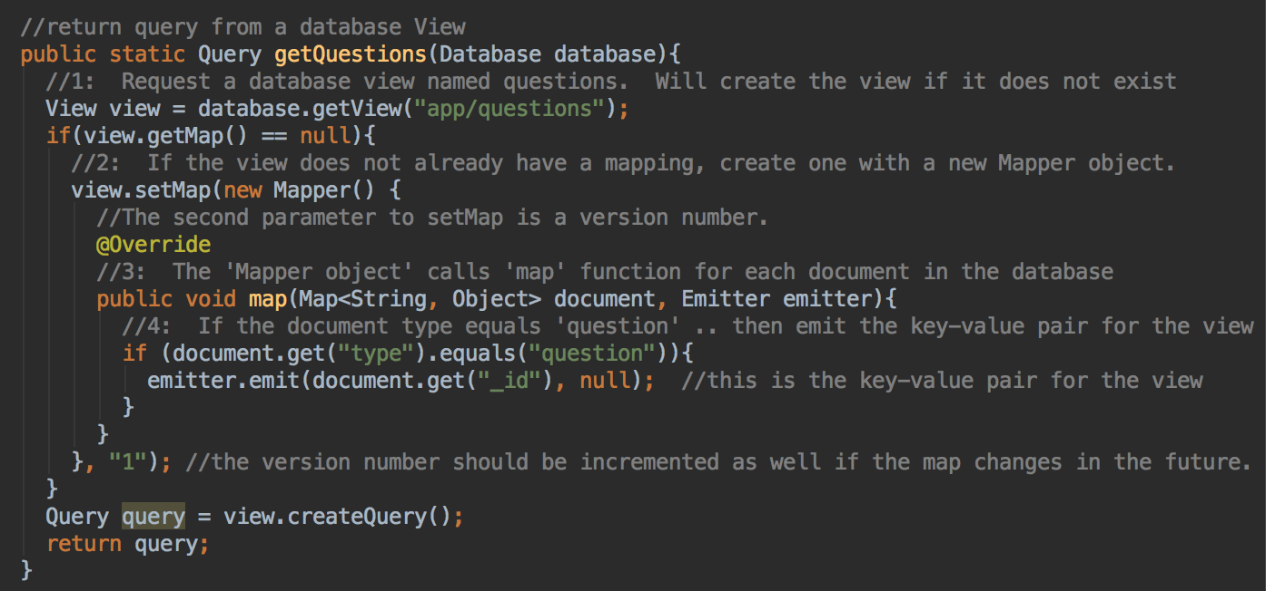
Database View

Slide 25
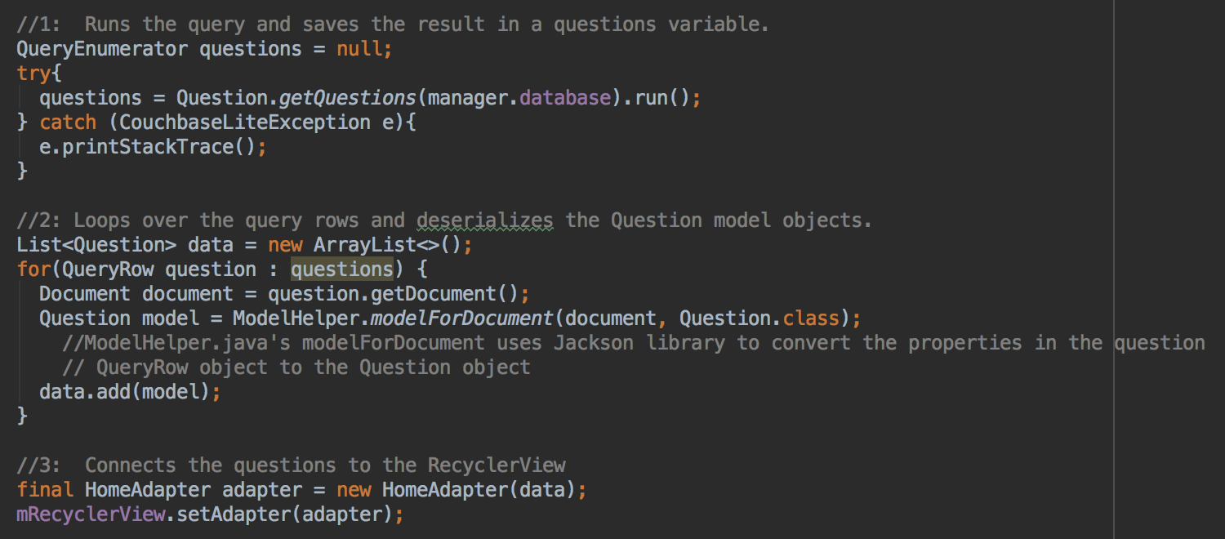
Database Query

Slide 26
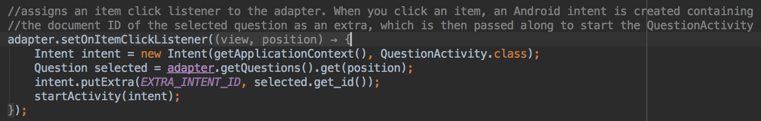
Document ID

Slide 27
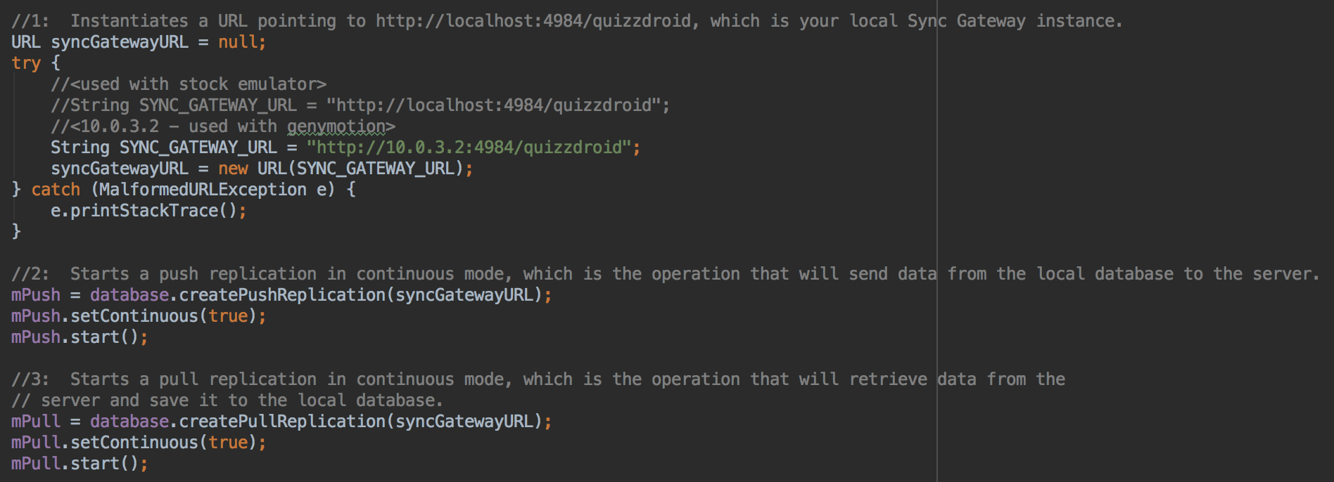
Synchronization

Slide 28
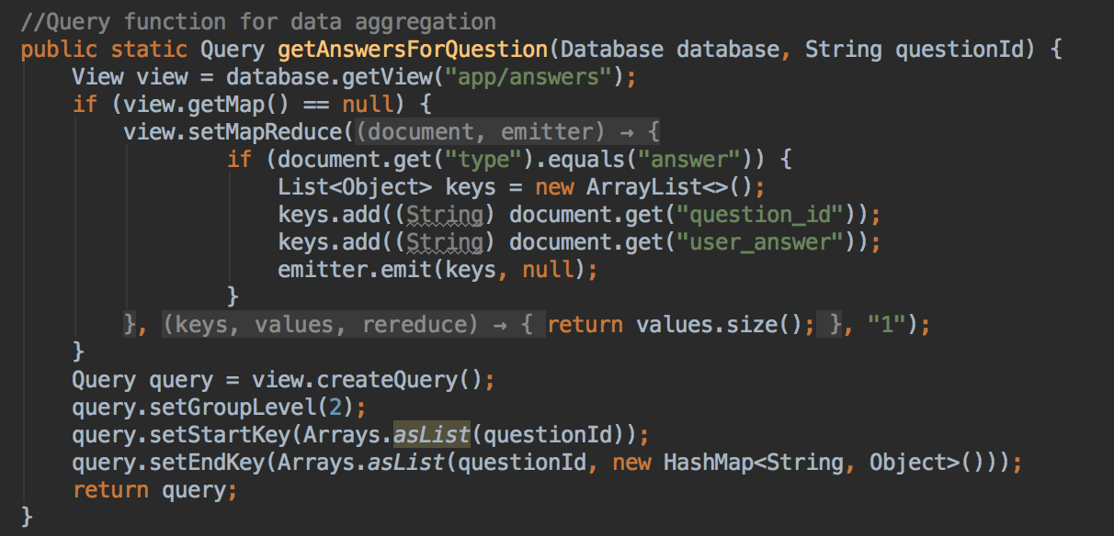
Aggregating Data

Slide 29
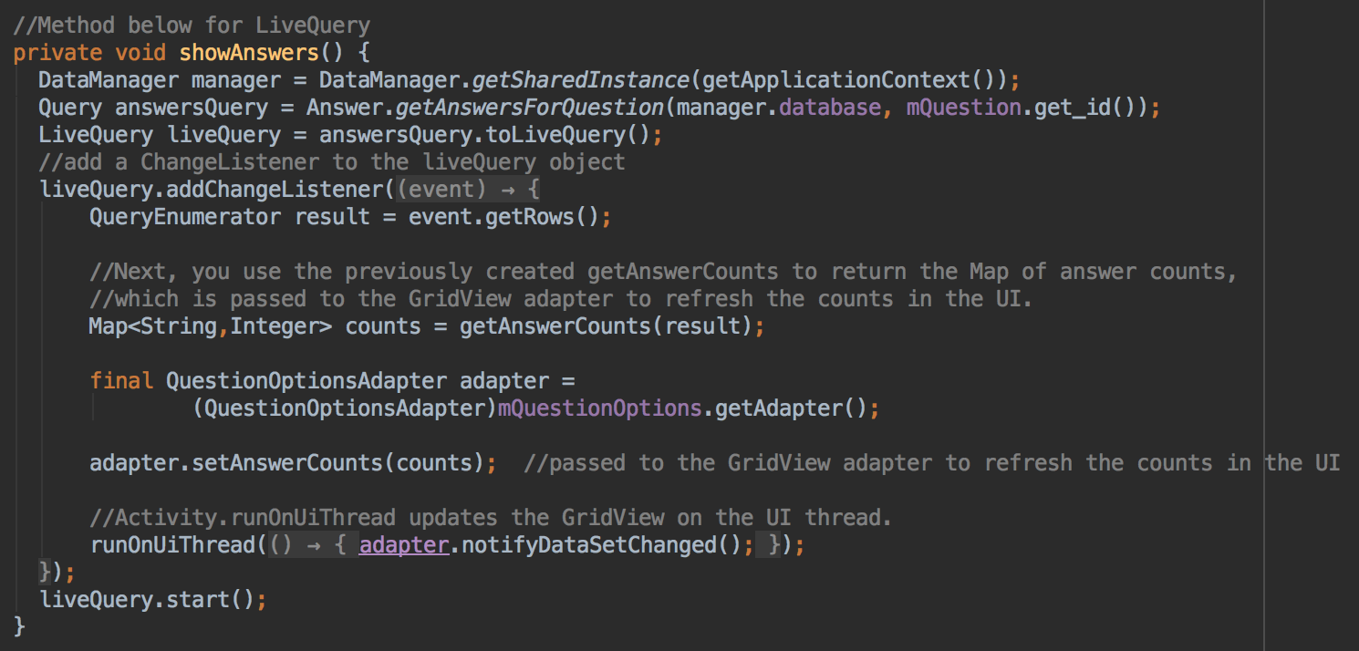
Live Query

Slide 30
https://docs.fabric.io/
@twitterdev
https://developer.couchbase.com/mobile/
@couchbasedev

Slide 31
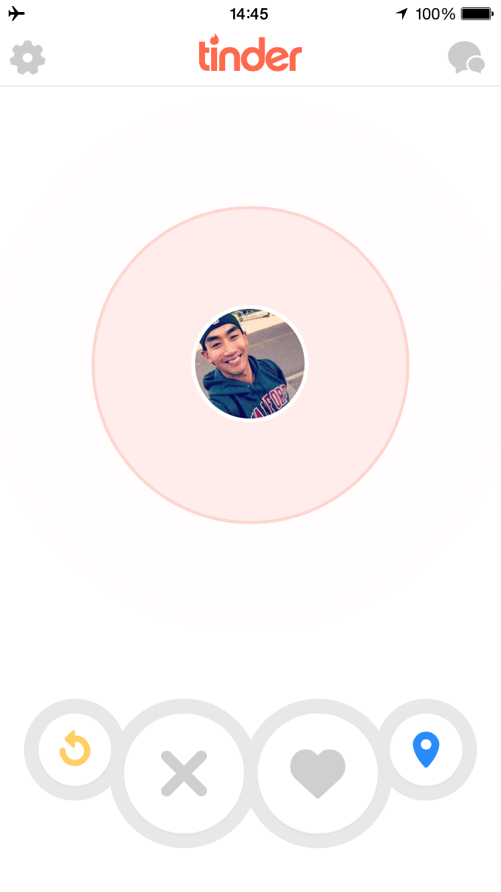
Offline Mobile Apps
William Hoang
Mobile Developer Advocate
@sweetiewill

Slide 32
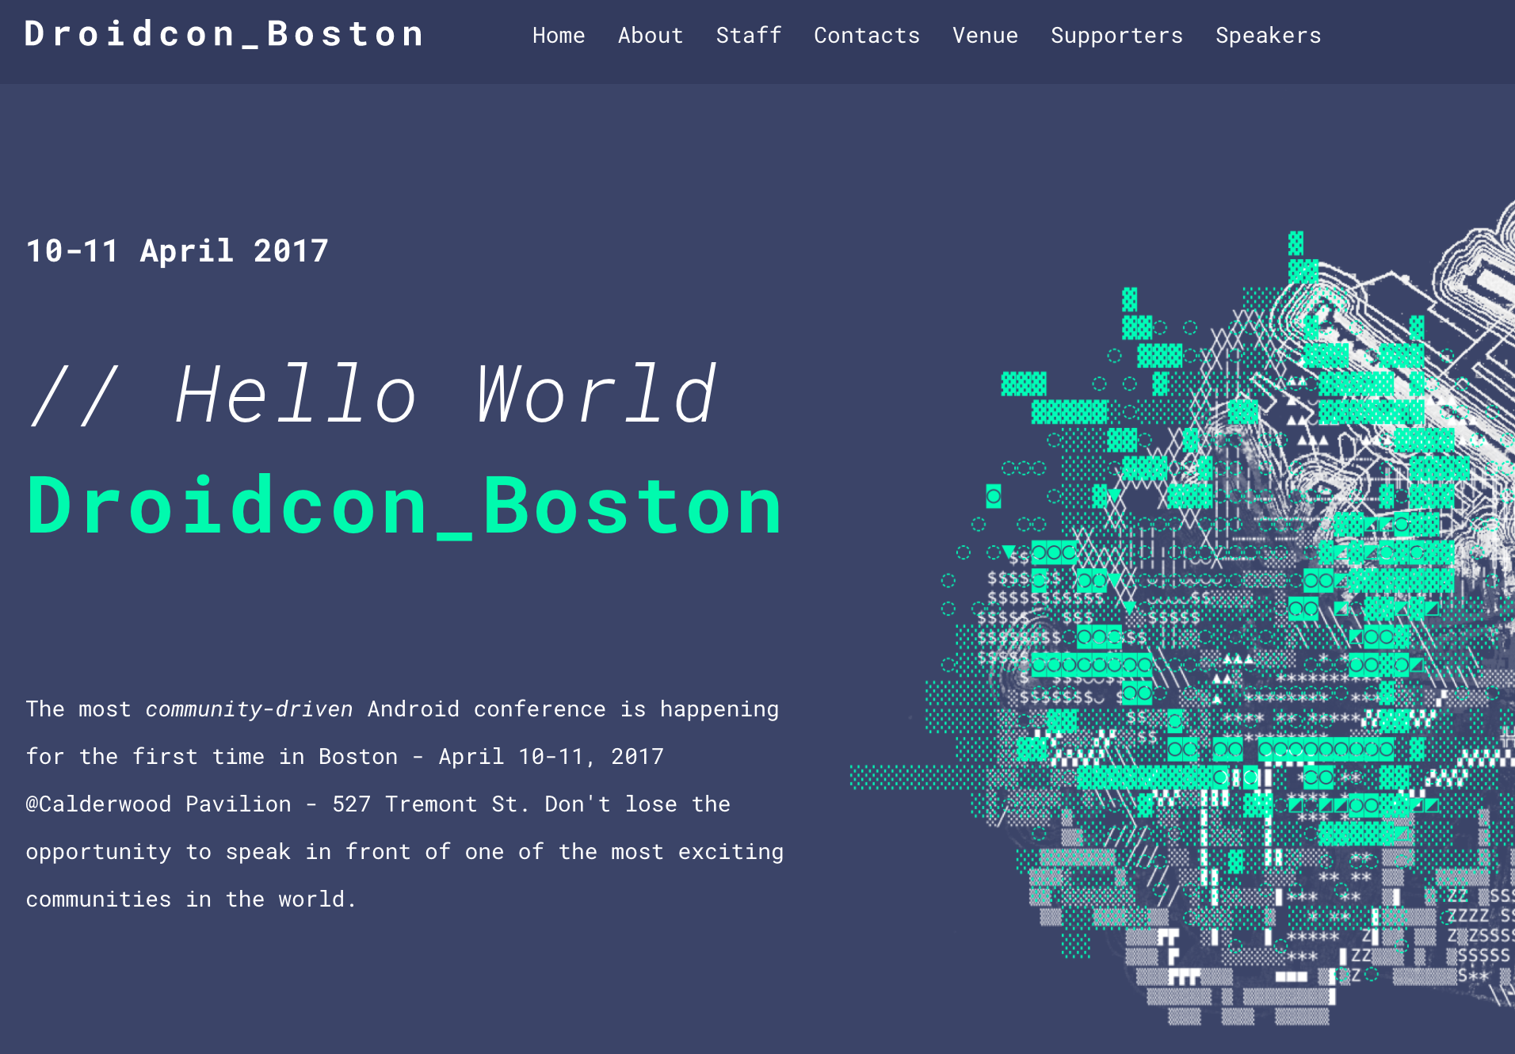
| William Hoang | Mobile Developer Advocate |
@sweetiewill

Slide 33
Thank you.
@sweetiewill

